Slide 1
Project:- Hotel Rating Classification
Group No: 3

Slide 2
Team Members
Miss. Pranjali Jeevan Rachchawar
MR. SAGAR BHAUSAHEB KHANDAVE
Mr ANAND KUMAR
Mr. Rangana Naveen Sai
Mr. U Yeshwanth Kumar
Mr. HAVISHMAN SHIVAJI GHATGE

Slide 3
Business Objective:
This is a sample dataset which consists of 20,000 reviews and ratings for different hotels and our goal is to examine how travelers are communicating their positive and negative experiences in online platforms for staying in a specific hotel and major objective is what are the attributes that travelers are considering while selecting a hotel. With this manager can understand which elements of their hotel influence more in forming a positive review or improves hotel brand image.

Slide 4
Data Information
In hotel review dataset we have 3 columns review, rating and @(null)
Review columns contains review given by the customer and rating colum given rating by the customer out of 5
Shape of dataset: (20491, 3)
in dataset missing value is Zero
Review Value Counts
Rating 5 :- 9054
Rating 4 :- 6039
Rating 3 :- 2184
Rating 2 :- 1793
Rating 1 :- 1421

Slide 5
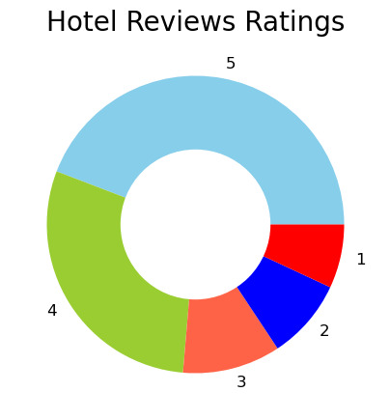
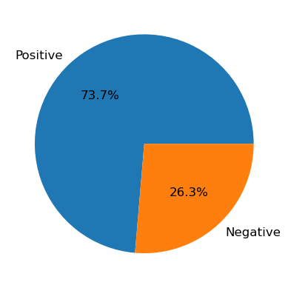
Eda (exploratory data analysis)
Based on the rating columns pie chart we visualize and according to chart we can easily visualize that by the customer 5 rating is given high and second most highest rating is 4
In Fig 2. we convert the rating based on 1to 3 is “Negative” and 4 to 5 rating into “positive”.
As per the chart we visualize that positive Review from customer is 73.7% whereas negative Review from customer is 26.3%
Fig 1
Fig 2

Slide 6
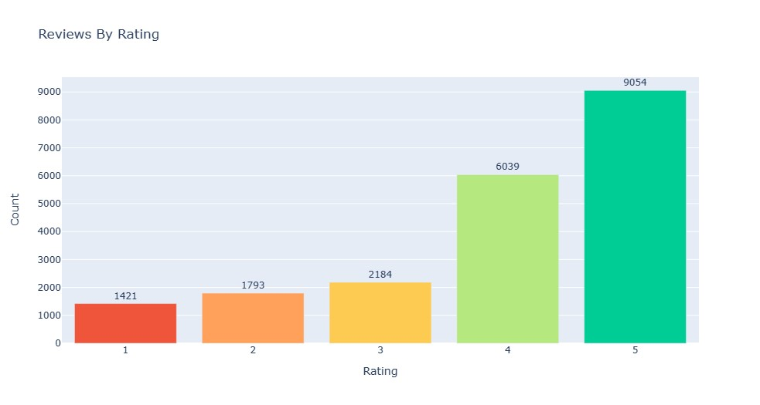
Reviews by rating
As per the visualization we can see that ap per the rating given by the customer we plotted the histogram plot
Where 1st rating :- 1421
2nd Ranting :- 1793
3rd Rating :- 2184
4th Rating :- 6039
5th Rating :- 9054

Slide 7
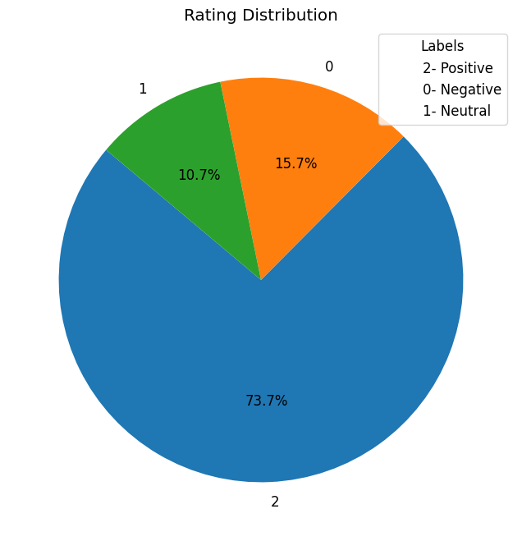
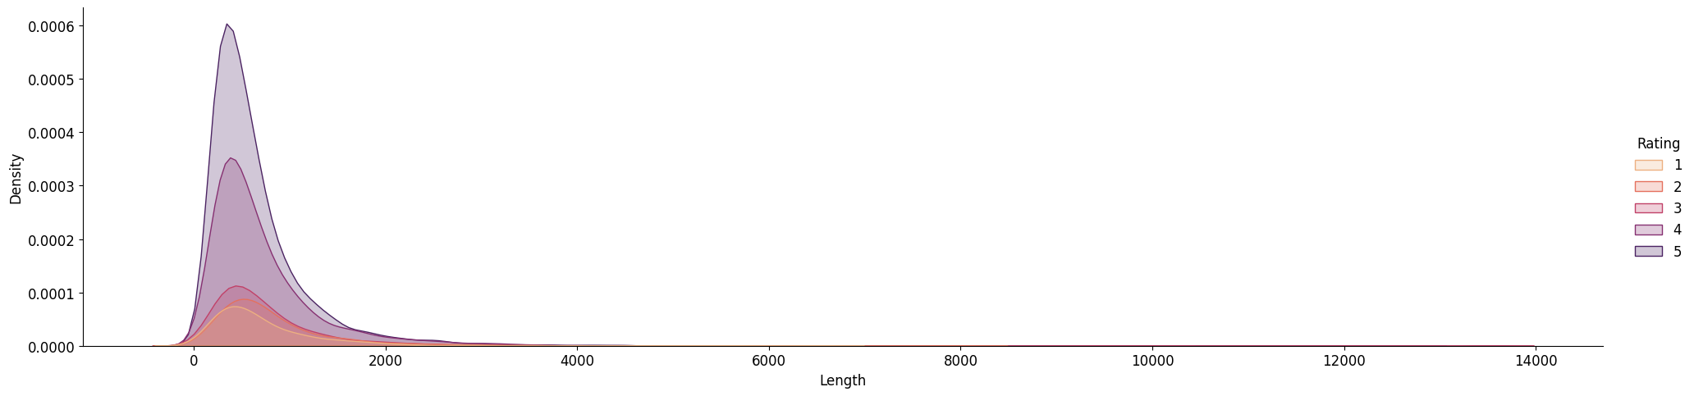
Rating distribution and Distplot
In Rating Distribution summarization of rating is plot in pie chart where 0 rating is Negative having 10.7%, 1 is for Nuetral rating having 15.7% and 2 for the Positive Rating having 73.7%
In Second plot the distribution of data is showing in the chart having distribution of chart in rating wise.

Slide 8
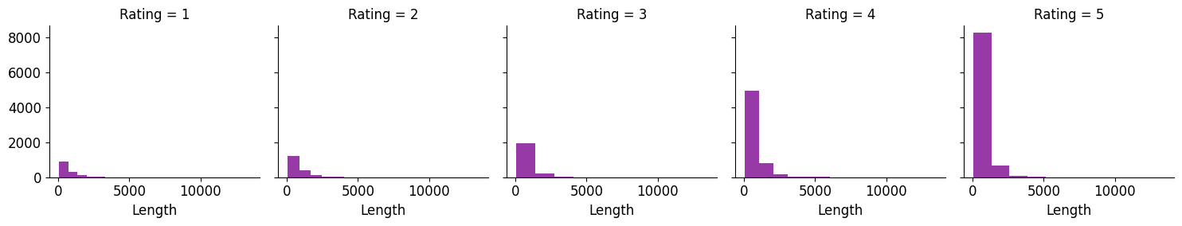
Plot Rating vs Length of review
In this chart the plotting of bar is rating vs lenth of review.
We can see in this plot rating of 5 having length 8000 approx.
But other review length is less compare to 5 Rating.

Slide 9
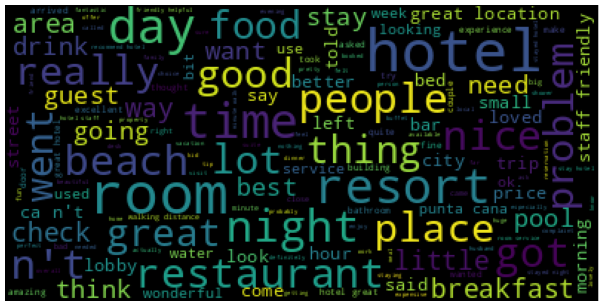
Word Cloud
Word cloud is represent to visualize the most appear data in review .
According to this visualization we can say out of many words that appear most compare to other words
Like hotel, people, room, resorts etc.

Slide 10
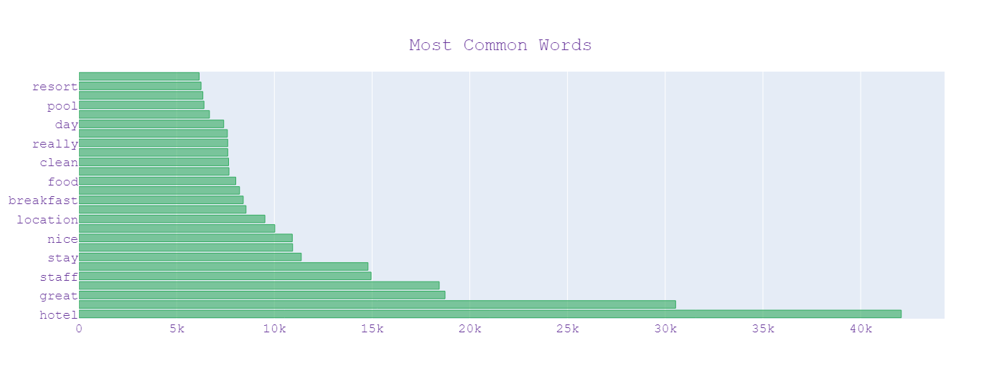
Most Common Words
In this visualization we can see that top 10 words that appear frequently.
Like hotel words appear more that 40k in complete review
After that great, staff, stay and other words are appeared similarly having high frequency of occurance

Slide 11
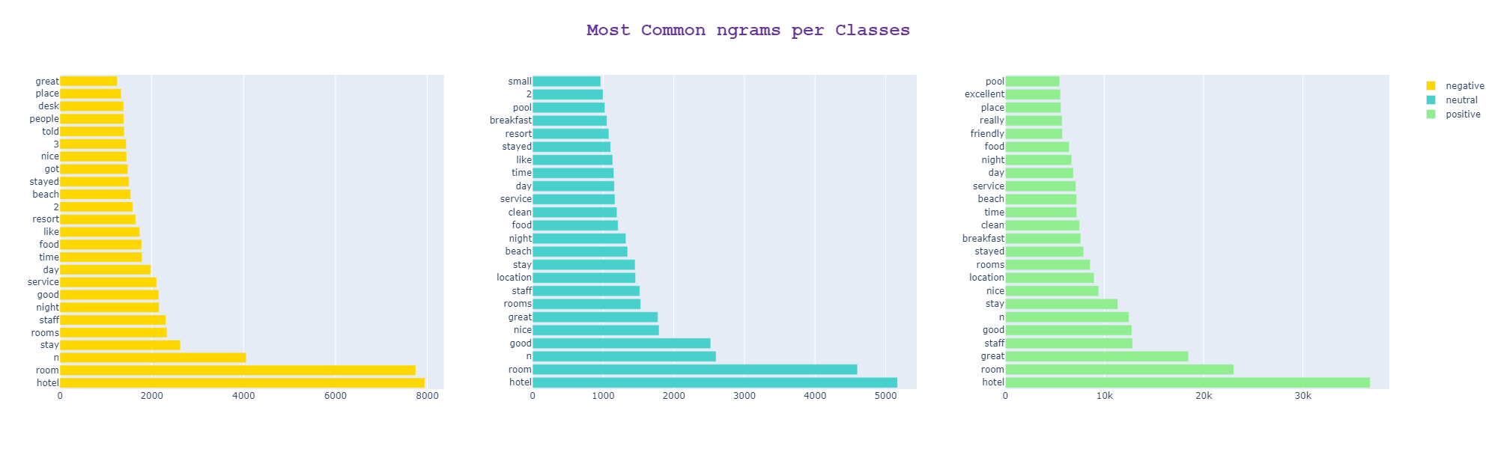
Most common words based on different class
In this visualization
Most appear words as per the different class is shown

Slide 12
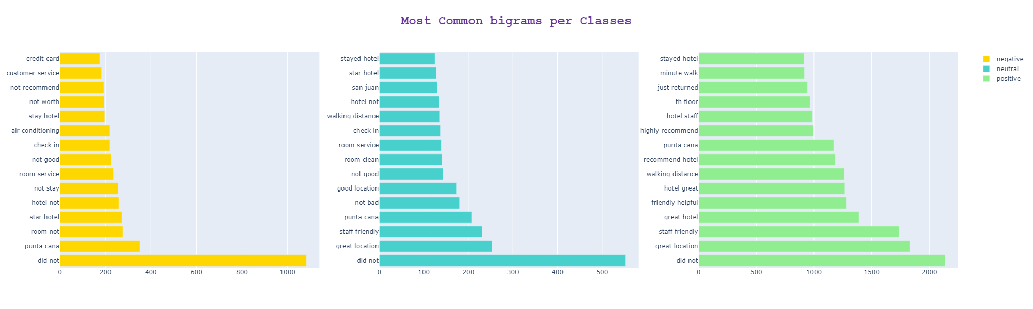
Most Common words Bigram per classes
In this visualization it shown bi gram where two-word sequence will appear together
In this also based on different classes most appear bi gram is shown

Slide 13
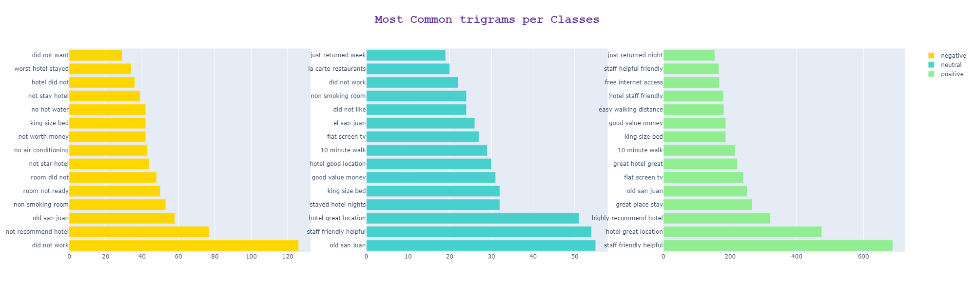
Most Common words trigram per classes
In this visualization it shown tri-gram where three-word sequence will appear together
In this also based on different classes most appear tri gram is shown

Slide 14
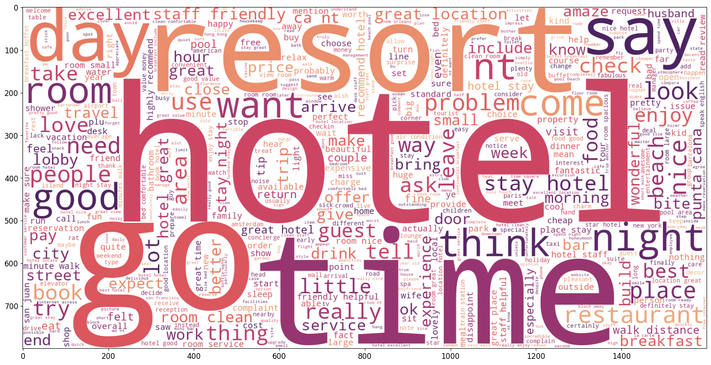
Word cloud before and after cleaning
Total text length BEFORE cleaning: 14861007
Total text length AFTER cleaning: 13544405

Slide 15
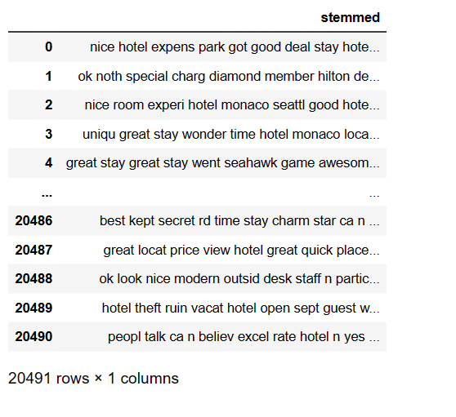
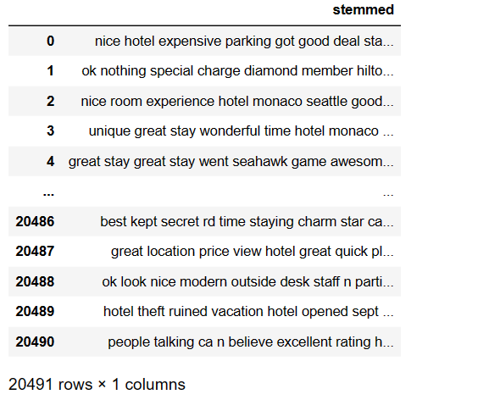
LEMMATIZER and STEMMER
Lemmatization is a text pre-processing technique used in natural language processing (NLP) models to break a word down to its root meaning to identify similarities.
Stemming, in Natural Language Processing (NLP), refers to the process of reducing a word to its word stem that affixes to suffixes and prefixes or the roots.

Slide 16
TEXT PRE-PROCESSING TECHNIQUES
Removing ‘@names’
Removing links (http | https)
Removing Review with empty text
Dropping duplicate rows
Function to remove emoji
Removing stop words

Slide 17
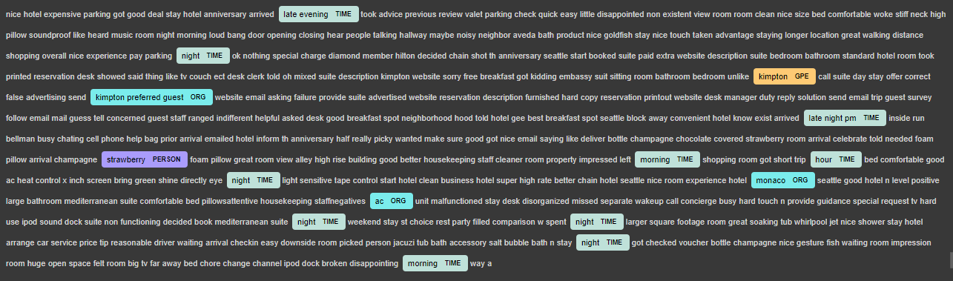
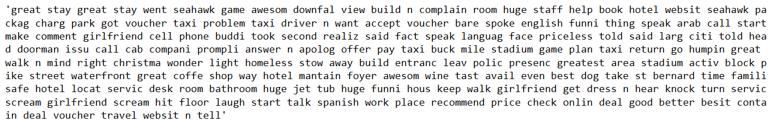
TF-IDF Vectorizer and NAMED ENTITY RECOGNITION(NER)
Named entity recognition (NER) is a form of natural language processing (NLP) that involves extracting and identifying essential information from text.
TF-IDF, short for Term Frequency-Inverse Document Frequency, is a commonly used technique in NLP to determine the significance of words in a document or corpus.

Slide 18
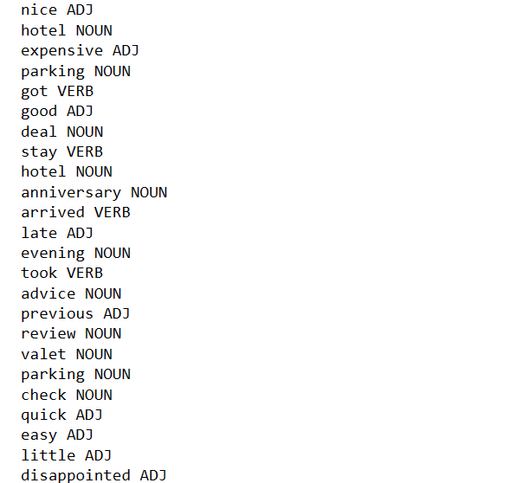
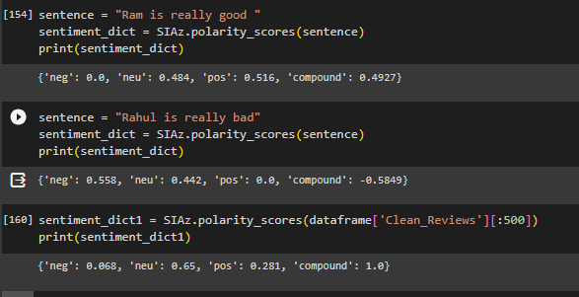

PARTS OF SPEECH (POS) TAGGING & VADAR SENTIMENTAL ANALYSIS
POS tagging is a useful tool in natural language processing (NLP) as it allows algorithms to understand the grammatical structure of a sentence and to disambiguate words that have multiple meanings.
VADER( Valence Aware Dictionary for Sentiment Reasoning) is an NLTK module that provides sentiment scores based on the words used. It is a rule-based sentiment analyzer in which the terms are generally labeled as per their semantic orientation as either positive or negative.

Slide 19
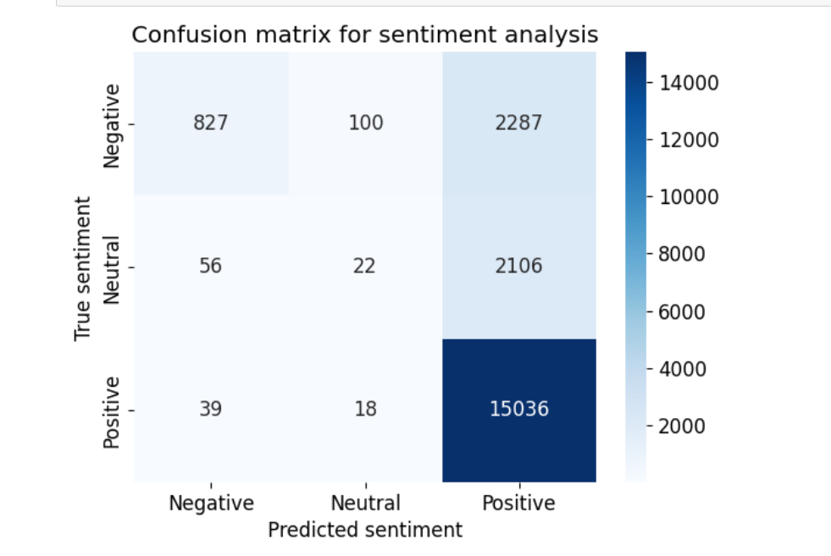
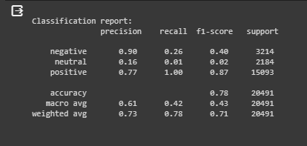
SENTIMENT ANALYSIS
Confusion Matrix Classification Report

